Slide 1


Welcome to Year 2’s
Meet the Teacher
Notes:
Thank you for coming. Please make sure to tick off your child’s name and take an information pack so we know which children need information packs sent home tomorrow.

Slide 2
Meet the Year 2 Team
Teacher | Teaching Assistants
Miss Wallek | Mrs B
PPA Cover: Mrs Mac will be teaching on a Monday afternoon
Notes:
Here is some key year 4 information. The year ____ staff consist of me, ________ as the full time class teacher. ____________ and _________ are our teaching assistants in the ___________.

Slide 3
Key Information
Registration | Lesson 1 | Lesson 2 | Break | Lesson 3 | Lunch | Lesson 4 | Lesson 5 | End of the day
8:45am Soft start | Phonics/Assembly | English | 10:30-10:45am | Maths | 12-1pm | RE | Science | Story/end of day prayer 3:20pm
PE Days | Forest School
Wednesday Thursday | Tuesday 15th September Tuesday 17th November Tuesday 19th January Tuesday 23rd March Tuesday 25th May
Notes:
This is an overview of our school times throughout the day and here is an example timetable, as you can see – school days are very busy so it is no surprise very tired children come home! Our PE days this half term are _____________.
Forest School dates for the year are _______

Slide 4
Homework
Reading | Timestables
All children should read for 10-15 minutes 5 days a week Reading records need to be signed at least once per week by a parent/guardian and handed in to the class teacher every week on Monday Reading record and books must be in everyday | Later in the year, the children will be given a login for Times Tables Rockstars.
Spellings – After October half-term, the children will begin the Little Wandle spelling program. They will then be set 10 spellings each week which will help them to practice the spelling rules they are learning in their phonics lessons.
Notes:
Decide on a day to hand in reading records each week and add
Use reading record as a example

Slide 5
Curriculum
Subject area | Autumn | Spring | Summer
English | Narrative Instructions | Narrative Letter writing | Non chronological reports Poetry Narrative
Maths | Place Value Addition and subtraction Shape | Money Multiplication and Division Length and Height Mass, capacity and temperature | Fractions Time Statistics Position and direction
RE | Creation and Covenant Prophecy and Promise | Galilee to Jerusalem Desert to Garden | To the Ends of the Earth Dialogue and Encounter
Science | Animals including Humans | Everyday materials Living things and their habitats | Plants
History | How was school different in the past? | How did we learn to fly? | What is a monarch?
Geography | Would you prefer to live in a hot or cold place? | Why is our world wonderful? | What is it like to live by the coast?
PE | Locomotion: Dodging Gymnastics Ball Skills | Ball skills Dance | Locomotion: Jumping Games for understanding Team Building Health and Wellbeing
Computing | Creating Media | Data and information | Programming
Music | Bumper harvest Magical Christmas Journey | I Wanna Play in a Banc Friendship Song | Healthy Living Reflect, Rewind and Replay
Art | Understanding tone and texture (drawing | Life in colour (painting and mixed media) | Clay houses (sculpture and 3D)
Design Technology | Baby bear’s chair (Structures) | Pouches (Textiles) | Balanced Diet (Cooking and nutrition)
Notes:
Here is an overview of things we will be studying in class each term.

Slide 6

Enrichment opportunities
PE trips
Panomime
Seaside
Notes:
Enrichment in Year _____ is………………….
Trips, competitions etc..that you know ARE happening. – E.G. Y5& 6 RESIDENTIAL,

Slide 7
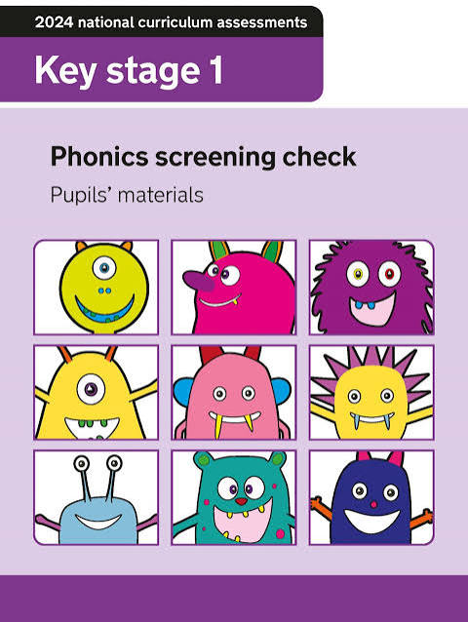
Phonics Screening Retakes
The Phonics Screening Check
is a statutory national assessment administered to Year 1 pupils (usually aged 6) in England to confirm they have learned phonic decoding to an age-appropriate standard
Year 2 Retake: Children who miss the pass mark in Year 1 take the assessment again during the official check window in June of Year 2.
The children that are retaking the assessment will be doing so the week beginning Monday 14th June 2027
Notes:
Specific year group info – such as Reception Baseline, SATS, Phonic check etc
e.G
The purpose of the MTC is to determine whether pupils can recall their times tables fluently, which is essential for future success in mathematics. It will help schools to identify pupils who have not yet mastered their times tables, so that additional support can be provided.
Please check the following website for more information.

Slide 8
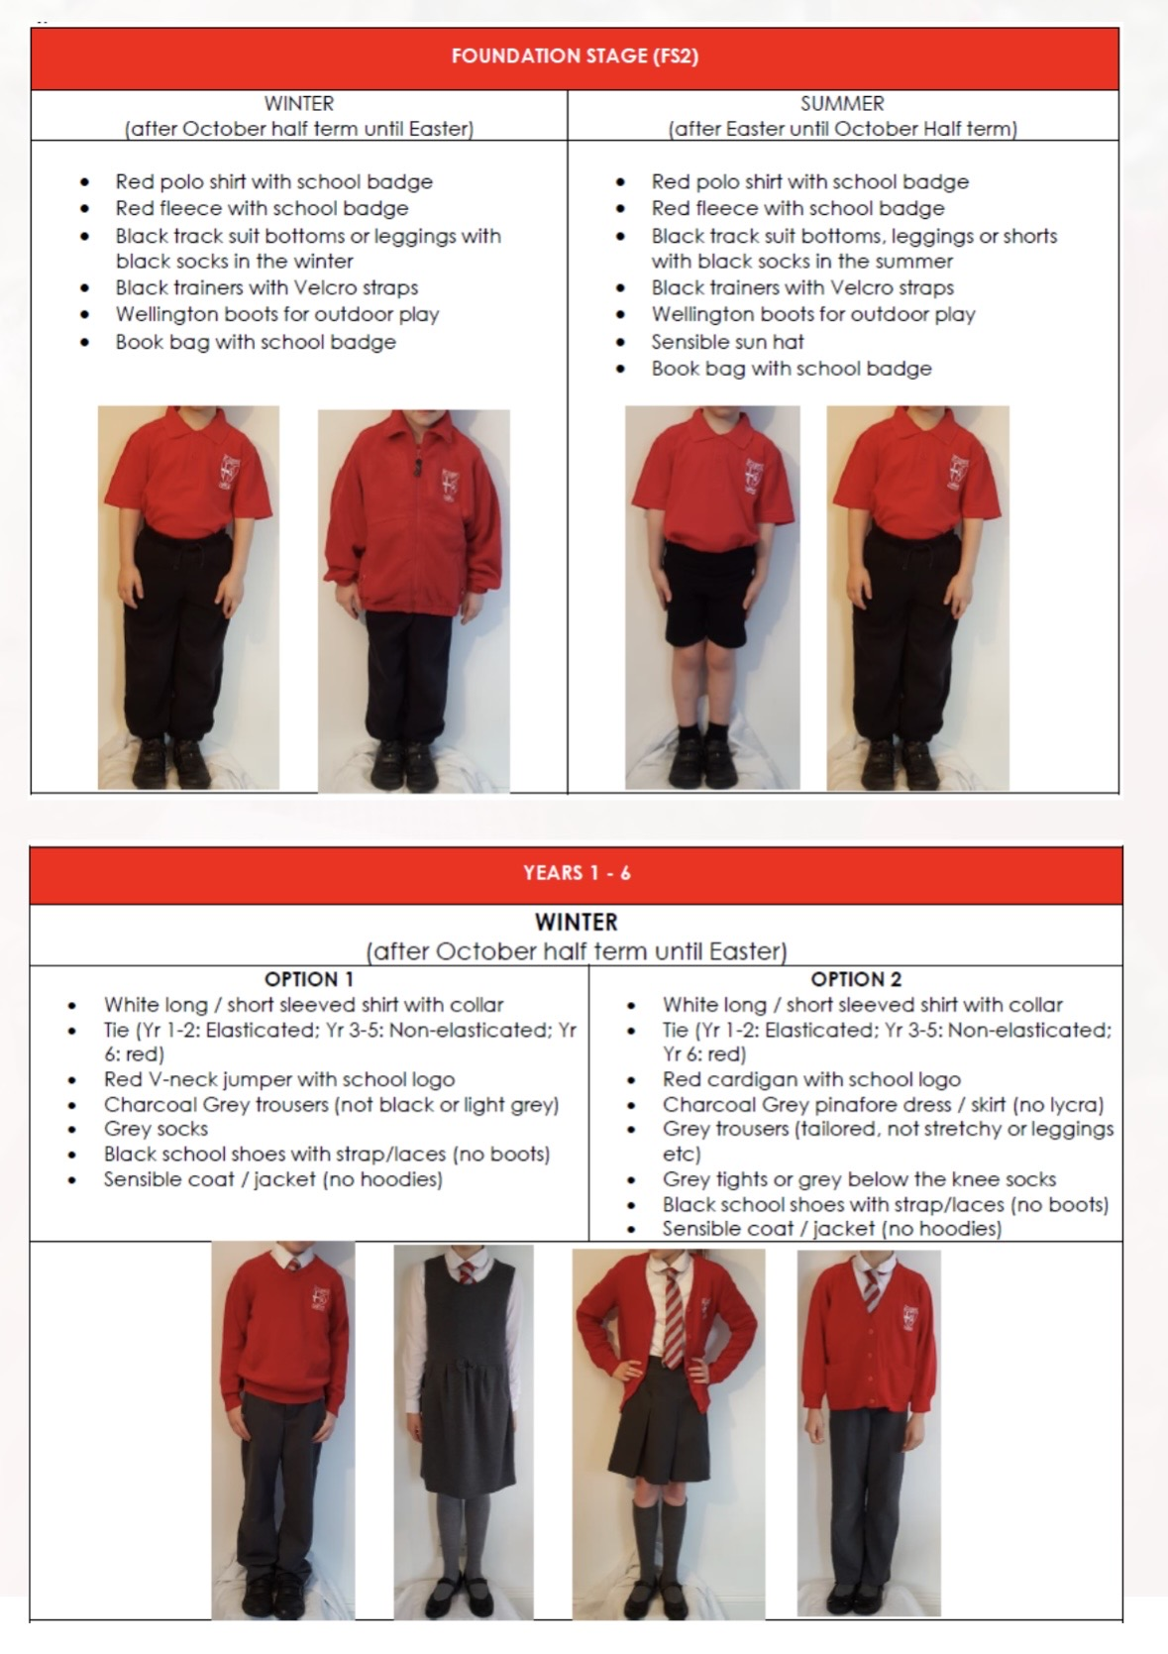
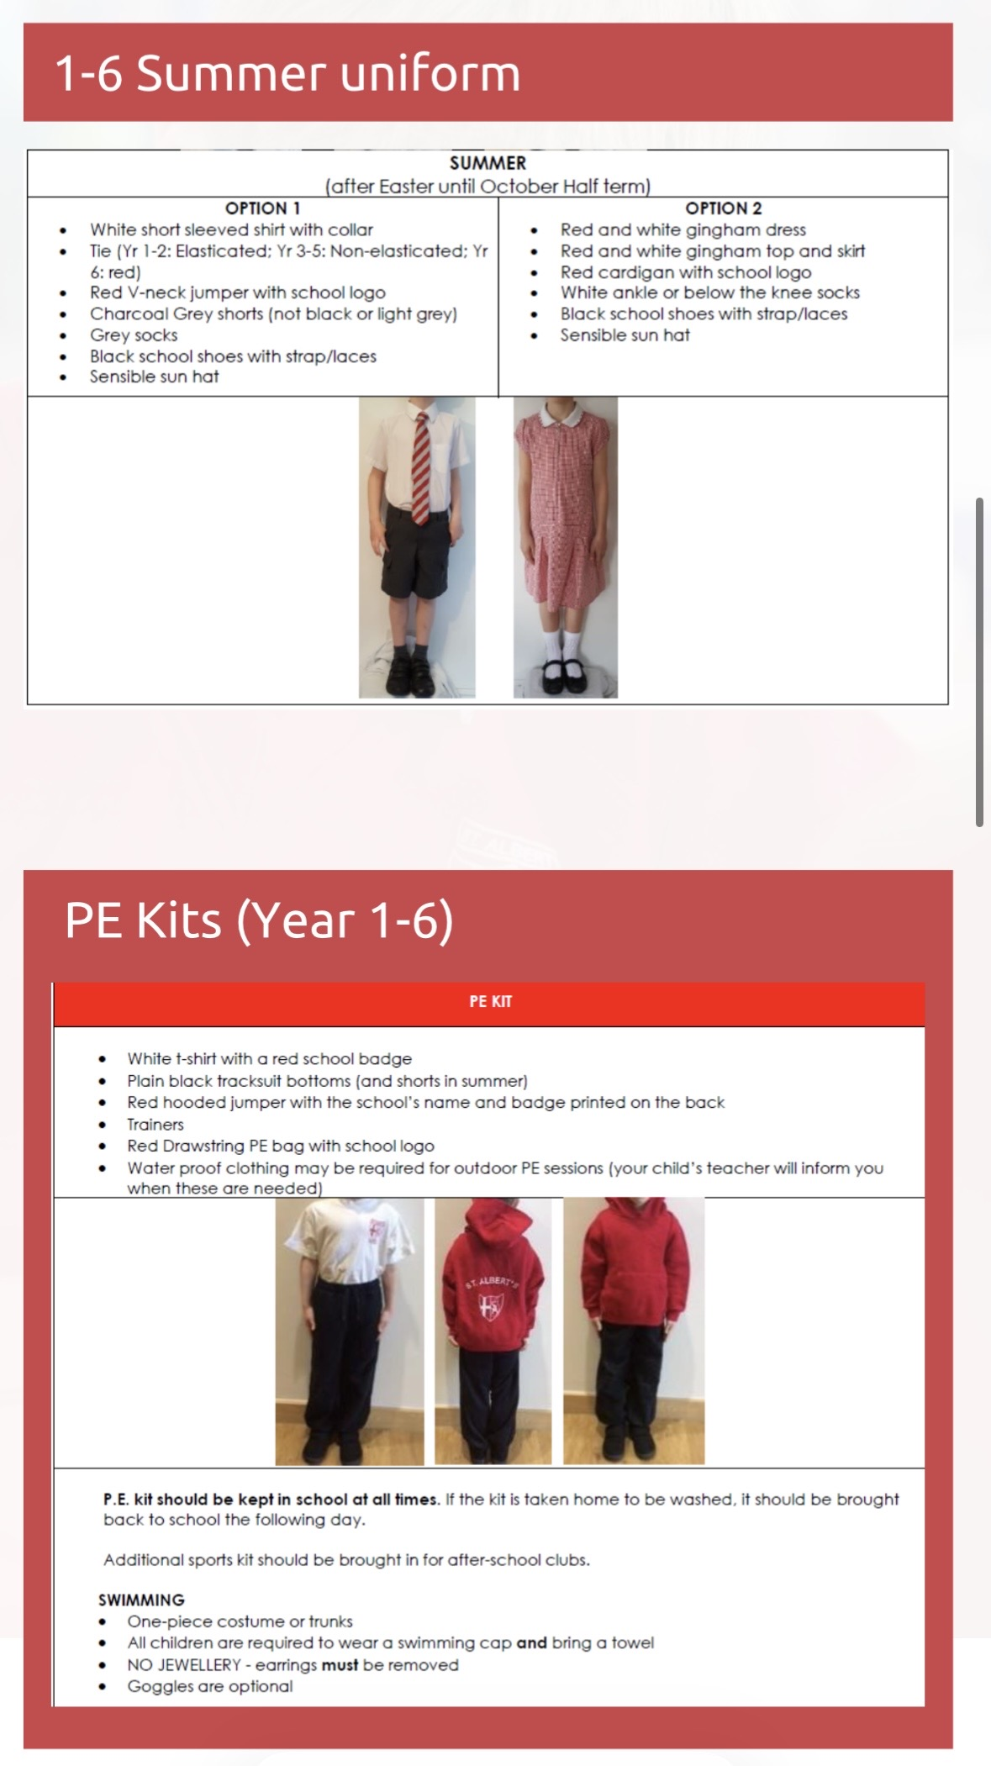
Uniform
Notes:
In year ________ we wear _________
PE kits consist of ______

Slide 9

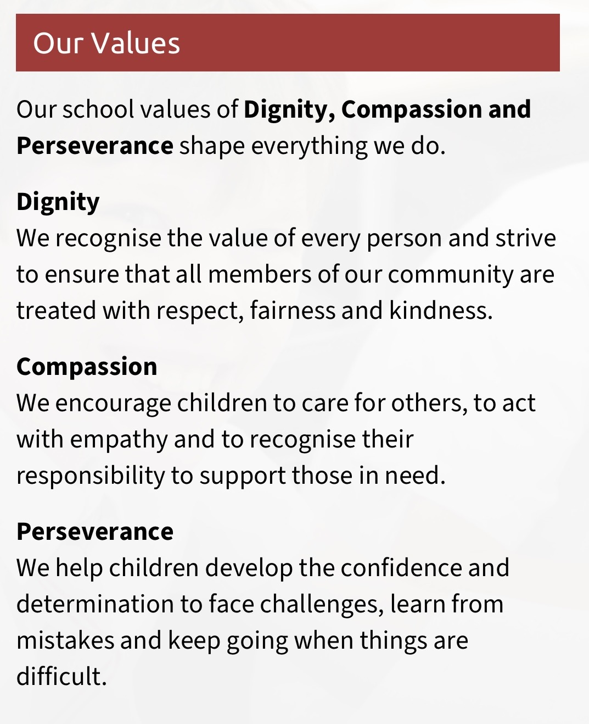
School mission and values
‘The more I learn about the world in which I live, the closer I grow to God’
Prayers to reinforce at home:
Our Father, Hail Mary, Glory Be, responses and key prayers used in Mass (Gloria, Creed etc.)
Notes:
Our mission statement – at the heart of what we endeavour to do. Showing the values we want the children to have
Treating others as we want to be treated
loving, respectful, kind, polite
Being honest
Forgiving one another
Supporting and valuing this at home
Reiterated in school through assemblies, class worship, regular links with local parishes to celebrate Mass, regular prayer.

Slide 10
How to get in contact:
Email - admin@albertthegreat.herts.sch.uk
Class Dojo – General information, badges and achievements etc.
Drop off/pick up times
Upcoming Important Dates:
Parent Consultation evenings – Tuesday 13th October and Wednesday 14th October
Learning Showcase – Wednesday 21st October

Slide 11

Questions?
Feel free to ask now or speak to me afterwards

