Slide 1


Welcome to Year 6’s
Meet the Teacher
Notes:
Thank-you for coming. Please make sure to tick off your child’s name and take an information pack so we know which children need information packs sent home tomorrow. Thankyou

Slide 2
Key Information
Year 6 Staff | Mrs Trent, Mrs Territ, Miss Holder, Miss Beardsworth PPA cover Mrs Telling
School times | Registration: 8.45 – 9.00 |  |  | Breaktime: 10.30 - 10.45 |  | Lunchtime: 12.00 - 1.00 |  | End of Day: 3.20
Example Timetable | Morning work / Registration | Guided Reading | English | Break | Maths | Lunch |  | PE RE
PE Days | Monday |  |  |  | Wednesday |  | Children to have PE kit in school
Notes:
Here is some key year 4 information. The year 4 staff consist of me, Miss Lally as the full time class teacher. Mrs Mulvihill and Mrs Dunlop are our teaching assistants in the mornings. On Wednesday mornings for a couple of hours Mrs Peerless takes the class.
This is an overview of our school times throughout the day and here is an example timetable, as you can see – school days are very busy so it is no surprise very tired children come home! Our PE days this halfterm are Tuesdays and Fridays.
Forest School halfterm?
Swimming term?

Slide 3
Forest School half term this year – WC 12th October
Residential – PGL dates TBC
Sports Trips

Slide 4
Curriculum areas and subject topics:
Maths – number and place value
English – Narrative
RE – The Bible → Creation
Science – Living Things and their Habitats
Topic - Geography – Why does population change?
PE – tri-golf, dance
Computing – The Internet, networks, servers, sharing information
and further learning through Art, Music and French
Enrichment Opportunities:
School Trips
Sport Trips
Notes:
Here is an overview of things we will be studying in class.

Slide 5
Homework:
Things to do at home:
Reading every day
Times Tables
Spelling
How can you further support at home?
Build in time to read and rehearse key skills like number bonds and times tables as well as time to relax and unwind
Take the pressure off
Developing self-motivation and learning good habits
Finding opportunities to build and encourage children’s learning outside of school time – Boggle, crosswords, wordsearch, times tables songs, sudoku, scrabble, strategy games: chess etc. – incidental learning

Slide 6
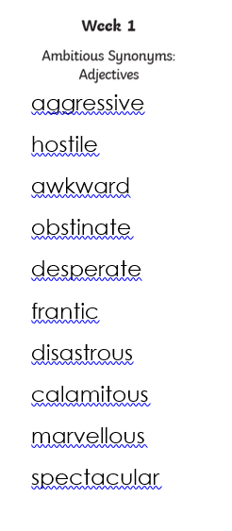
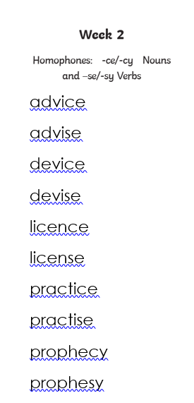
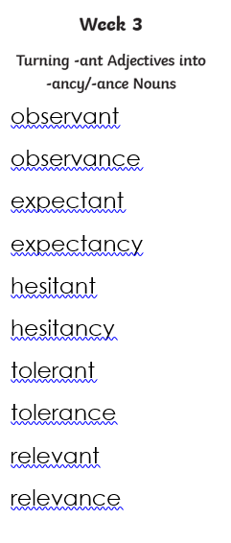
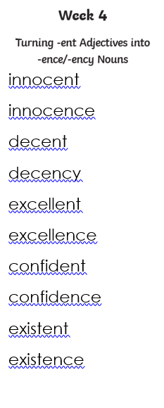
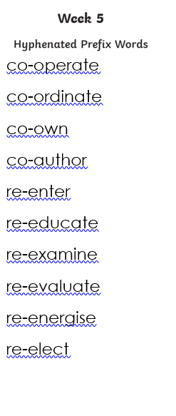
Spelling – independent, accurate application, test every Friday
Notes:
End of year expectations for spelling – regular spelling lessons identifying rules and patterns so children apply them of their own accord because they understand why y sometimes changes to ies etc.

Slide 7
Year 6 SATs
SATs are the Standardised Assessment Tests that are given to children at the end of Key Stage 2.
The SATs take place over four days (last year they started on Monday 10th May and ended on Thursday 13th May).
○ Grammar, punctuation and spelling (paper 1: GPS) – Monday 10th May 27
○ Grammar, punctuation and spelling (paper 2: Spelling) – Monday 10th May 27
○ Reading – Tuesday 11th May 27
○ Maths (paper 1: Arithmetic) – Wednesday 12th May 27
○ Maths (paper 2: Reasoning) – Wednesday 12th May 27
○ Maths (paper 3: Reasoning) – Thursday 13th May 27
Further Information
https://www.gov.uk/government/publications/key-stage-2-national-curriculum-tests-and-results-information-for-parents/2025-key-stage-2-national-curriculum-tests-information-for-parents
Notes:
Fairly new for year 4 is the government’s times tables check or multiplication tables check. It launched a couple of years ago but due to several lock downs, it has been optional until now. All children will sit the 5 minute check which consists of 25 random times tables questions up to 12x12. It is done digitally on a tablet or laptop and children will have the opportunity to practise beforehand. Children will have 6 seconds to answer each question, at which point whatever is in the answer box will be taken as their response. There is no pass mark as such, but the number of children who score 25/25 will be reported to the local authority etc., and used by us to identify who needs further support with their multiplication.

Slide 8
Key Stage 2 Reading
The reading test is a single paper with questions based on three passages of text. Your child will have one hour, including reading time, to complete the test.
There will be a selection of question types, including:
Ranking/ordering, e.g. ‘Number the events below to show the order in which they happen in the story’
Labelling, e.g. ‘Label the text to show the title of the story’
Find and copy, e.g. ‘Find and copy one word that suggests what the weather is like in the story’
Short constructed response, e.g. ‘What does the bear eat?’
Open-ended response, e.g. ‘Look at the sentence that begins Once upon a time. How does the writer increase the tension throughout this paragraph? Explain fully, referring to the text in your answer.’
Key Stage 2 Grammar, Punctuation and Spelling test
The grammar, punctuation and spelling test consists of two parts: a grammar and punctuation paper requiring short answers, lasting 45 minutes, and an aural spelling test of 20 words, lasting around 15 minutes.
The grammar and punctuation test will include two sub-types of questions:
Selected response, e.g. ‘Identify the adjectives in the sentence below’
Constructed response, e.g. ‘Correct/complete/rewrite the sentence below,’ or, ‘The sentence below has an apostrophe missing. Explain why it needs an apostrophe.’

Slide 9
Key Stage 2 Maths
Children sit three papers in maths:
Paper 1: arithmetic, 30 minutes
Papers 2 and 3: reasoning, 40 minutes per paper
Paper 1 will consist of fixed response questions, where children have to give the correct answer to calculations, including long multiplication and division. Papers 2 and 3 will involve a number of question types, including:
Multiple choice
True or false
Constrained questions, e.g. giving the answer to a calculation, drawing a shape or completing a table or chart
Less constrained questions, where children will have to explain their approach for solving a problem
Assessment and reporting
You will be given your child’s raw score (the actual number of marks they get), alongside their scaled score and whether they have reached the expected standard set by the Department for Education
The range of scaled scores available for each KS2 test is:
80-99- working below the national Expected Standard
100- 110 working at the Expected Standard
111-120 exceeded the Expected Standard

Slide 10
How to get in contact:
Our Website - https://www.albertthegreat.herts.sch.uk/index.asp
Email – admin@albertthegreat.herts.sch.uk
Class Dojo– General information etc.

Slide 11
Upcoming Important Dates:
Parent Consultation evenings – 13th and 14th October
Individual and sibling Photographs – 13th October
Learning Showcase – 21st October from 3.30pm

