Slide 1


Welcome to Reception
Meet the Teacher
Notes:
Thank you for coming. Please sign your name beside your child’s name.

Slide 2
Meet the Team
Teacher | Teaching Assistants
Mrs Watts Mrs Turp (EYFS Lead) | Mrs King Mrs Hanniffy Mrs McIntosh
Notes:
The reception staff consist of me, ________ as the full time class teacher. ____________ and _________ are our teaching assistants in the ___________and Mrs Mac will cover my time to plan lessons. Overseeing all of us is Mrs Turp, the EYFS Lead.

Slide 3
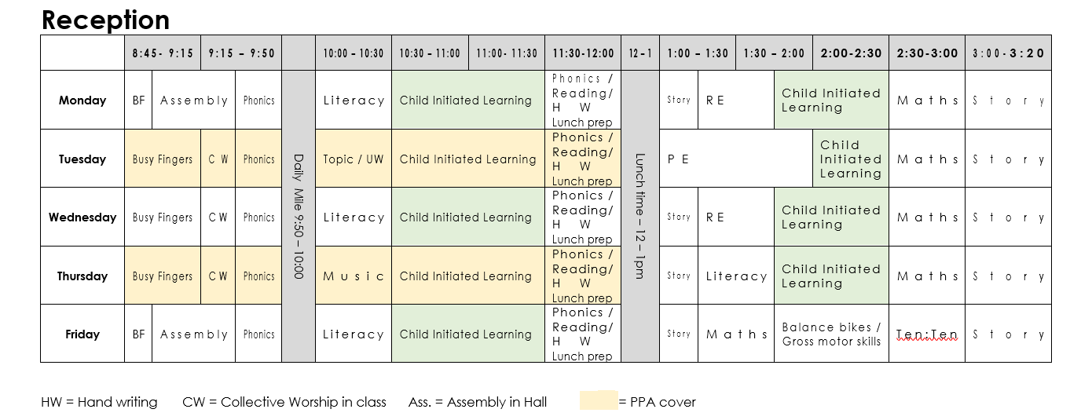
Key Information - Timetable
Notes:
Here is a weekly timetable and as you can see – school days are very busy so it is no surprise very tired children come home! Our PE days this half term are Tuesday and Friday afternoon.
Forest School dates for the year are WB 19th Oct, WB 8th March and WB 12th July

Slide 4
Curriculum Areas and Subject Topics
Prime Areas:
Communication and Language
Physical Development
Personal, Social and Emotional Development
Specific Areas:
Literacy
Mathematics
Understanding the World
Expressive art and design
Religious Education
Notes:
Here are the seven areas of learning in the Early Years Foundation Stage (EYFS) curriculum used in Reception. The children have 3 books, 1 writing book, learn the sound write it, progress to words, then to sentences, 1 RE and 1 workbook which contains Literacy and UW.

Slide 5
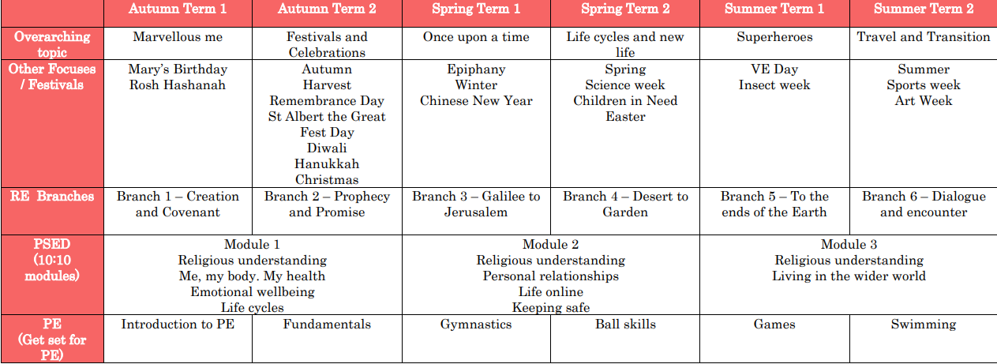
Curriculum
Notes:
Here is an overview of things we will be studying in class each term.

Slide 6
Reception Baseline Assement
The Reception Baseline Assessment (RBA) has been a statutory assessment since 2021. It highlights pupils’ readiness when they begin school and provides a starting point to measure the progress schools make with their pupils between reception and the end of primary school.
The children must take the assessment within the first 6 weeks of starting reception.
The RBA is a 20-minute, interactive activity-based, 1-to-1 assessment that has been designed to capture the starting levels of a child's early literacy, mathematics, language and communication skills.

Slide 7
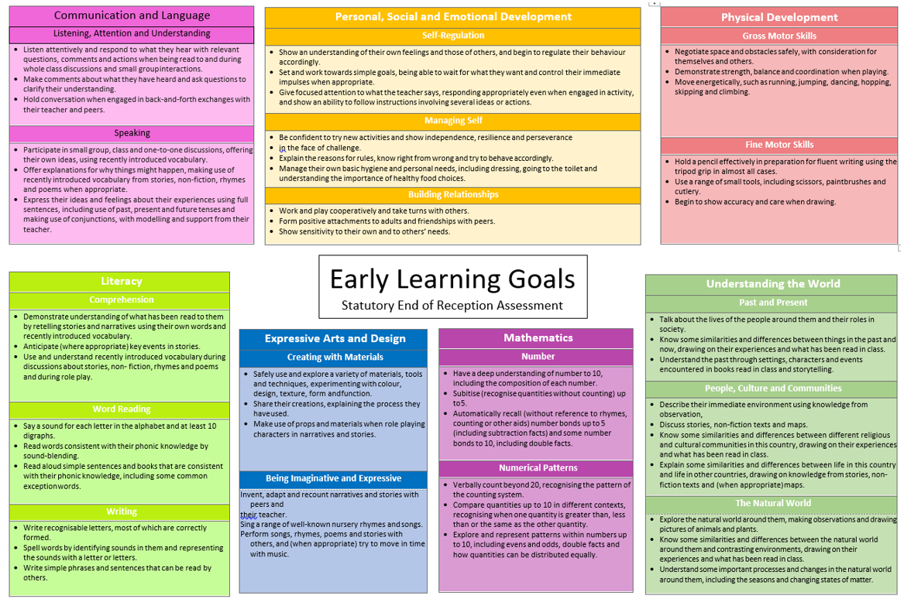
Notes:
Here is a weekly timetable and as you can see – school days are very busy so it is no surprise very tired children come home! Our PE days this half term are Tuesday and Friday afternoon.
Forest School dates for the year are WB 19th Oct, WB 8th March and WB 12th July

Slide 8
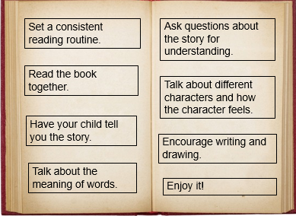
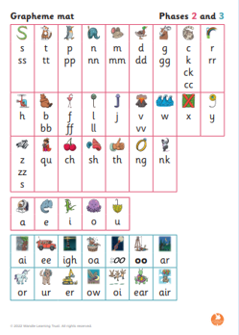
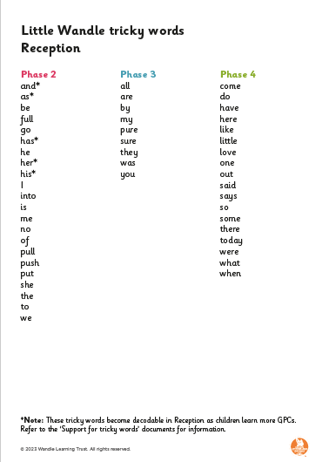
Homework
Reading | Phonics
Children must read for 10 minutes 5 days a week Reading records need to be signed by a parent/guardian Reading record and books must be in everyday | Children practice phonics
Notes:
Reading is a skill that needs time to develop. Our children are at the beginning of this journey and we want them to enjoy it from the very beginning. This can be difficult after a day at school so we must try and use strategies and techniques to help them learn this skill. In order to read children will learn phonics, the sounds in words. This will be taught daily, but practising them at home at support the development and by being consistent will really embed it. There are quite a few sounds to learn as well as tricky words so we will all be together on our children’s journey of learning to read. This week I will send home all the new sounds for this half term. I will let you know which sounds we have taught the children in the week so you can practise them at home.
If you ever need advice or information please come and speak to us, we will always do our best to support you at home with this.
The children will have a reading book each week. This is a reading record. We will write in the date and book title. Every time you read with your child please sign the book so we know your child has read. Please comment how the reading went - read well, struggled sounding the word cat, or, struggled to read so we looked for the s sound in the words. If you can, always find a different of reading the book, you read the book!

Slide 9

Enrichment opportunities
- Forest School
- External Sporting Activities
- Pantomime
- Summer Trip
- Mass at church
- Year 6 buddy
Notes:
Enrichment in Year _____ is………………….
Trips, competitions etc..that you know ARE happening. – E.G. Y5& 6 RESIDENTIAL,

Slide 10
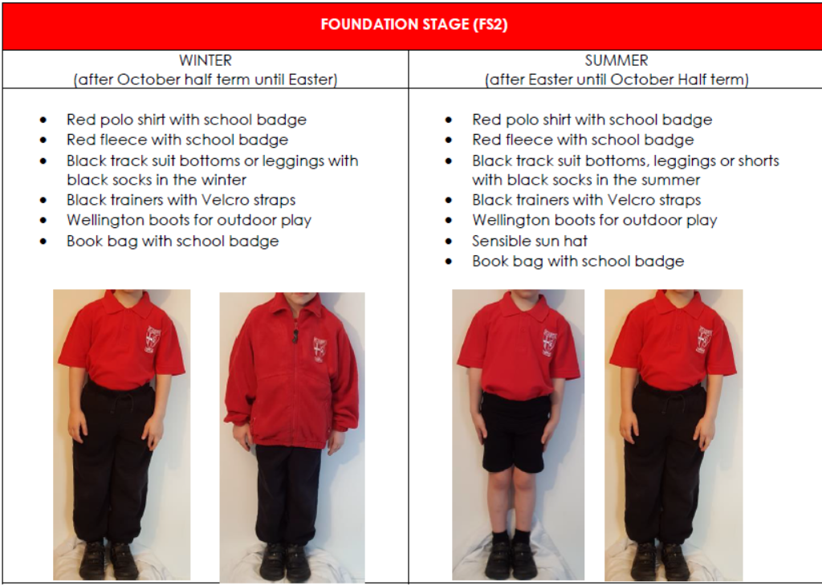
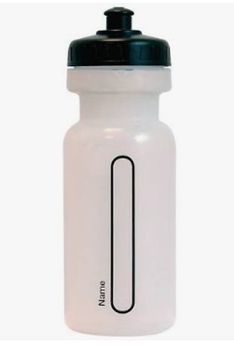
Uniform
Notes:
In reception the children wear red top and red fleece with tracksuit bottoms, joggers, leggings and shorts in the summer. Children in reception do not wear school skirts, trousers, school jumper or cardigan. Please consider your child skill of independence. They will be taking themselves to the toilet so having ties that they may find tricky will not be practical for them. Same with jackets/shoes. Also water bottles, if it is nearly the same size as your child, then it is not practical. If is has a lock, twist, pull then your child will not be able to open it. With all that I might not be able to open if for them! Lets encourage in dependence, not show them how good we are at these skills.

Slide 11

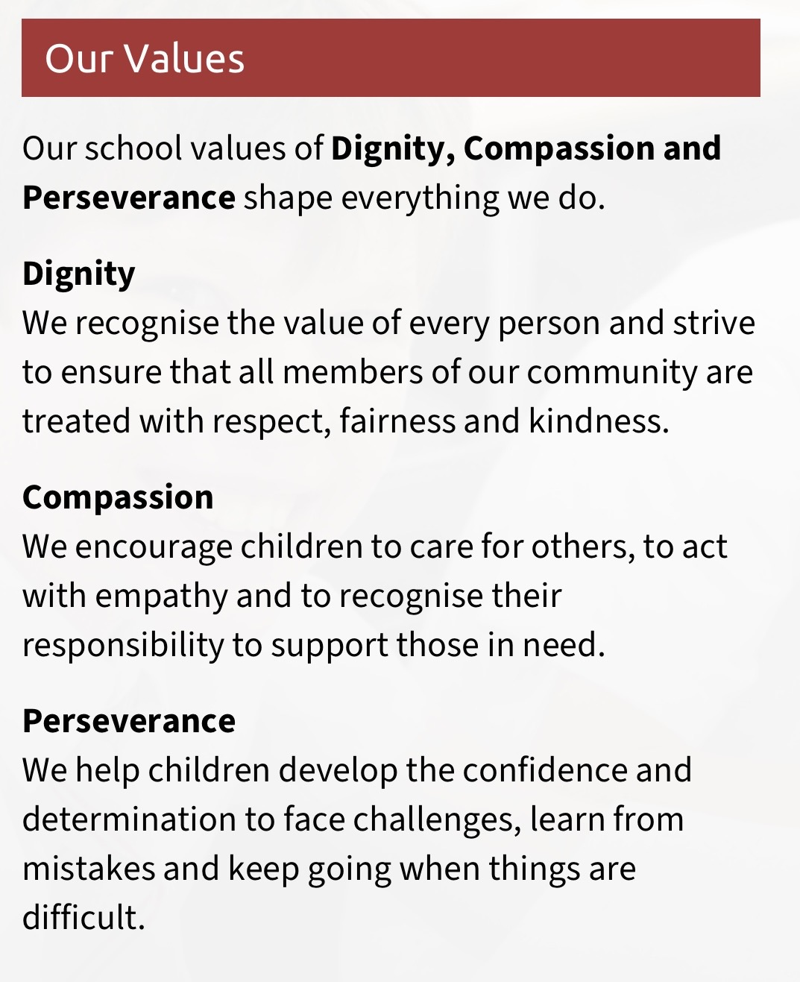
School mission and values
‘The more I learn about the world in which I live, the closer I grow to God’
Prayers to reinforce at home:
Our Father, Hail Mary, Glory Be, responses and key prayers used in Mass (Gloria, Creed etc.)
Notes:
Our mission statement – at the heart of what we endeavour to do. Showing the values we want the children to have
Treating others as we want to be treated
loving, respectful, kind, polite
Being honest
Forgiving one another
Supporting and valuing this at home
Reiterated in school through assemblies, class worship, regular links with local parishes to celebrate Mass, regular prayer.

Slide 12
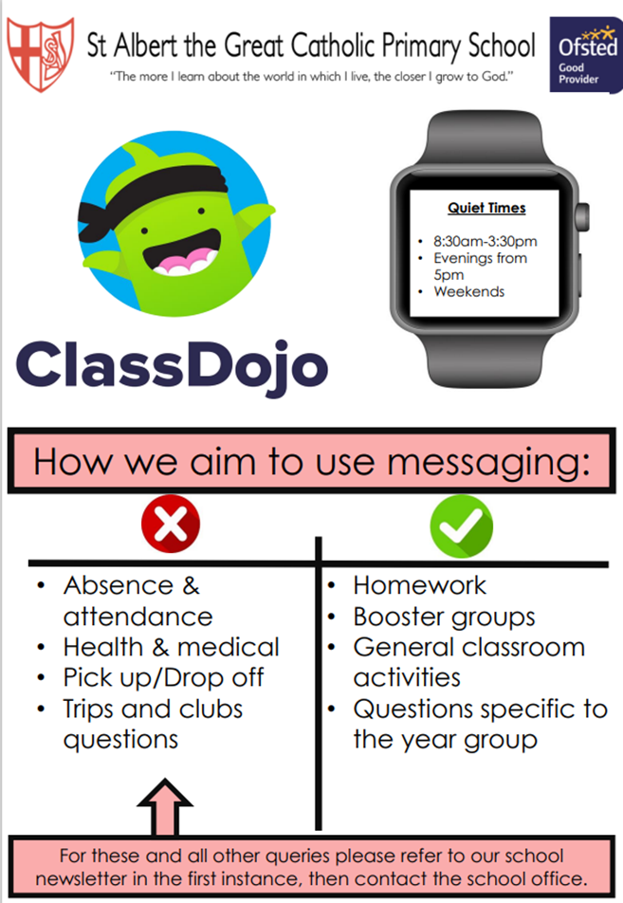
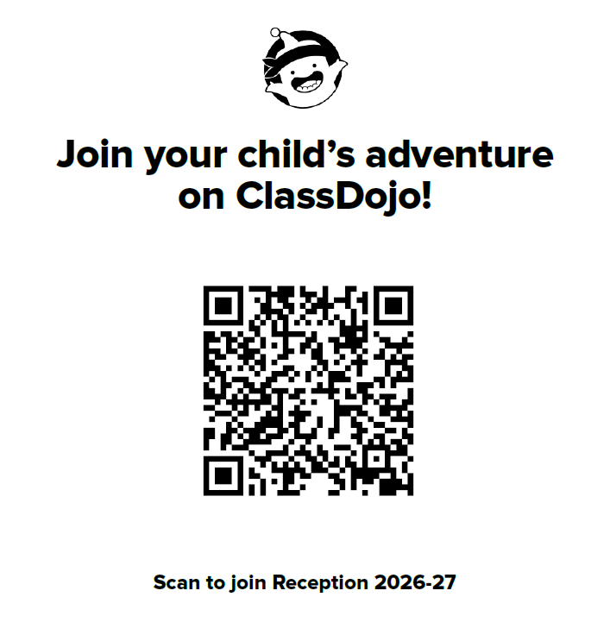
How to get in contact:
Email - admin@albertthegreat.herts.sch.uk
Class Dojo – General information, badges and achievements etc.
Drop off/pick up times
Upcoming Important Dates:
Parent Consultation evenings – Tuesday 13th and Wednesday 14th October
Learning Showcase – Wednesday 21st October
Notes:
Email – office address to me
Class Dojo - messaging
Our door is always open and if you ever need us we are here. We are working together not alongside each other.

Slide 13

Questions?
Feel free to ask now or speak to me afterwards
Notes:
Thank you for coming

